Slide 1
Welcome to
ART

Slide 2
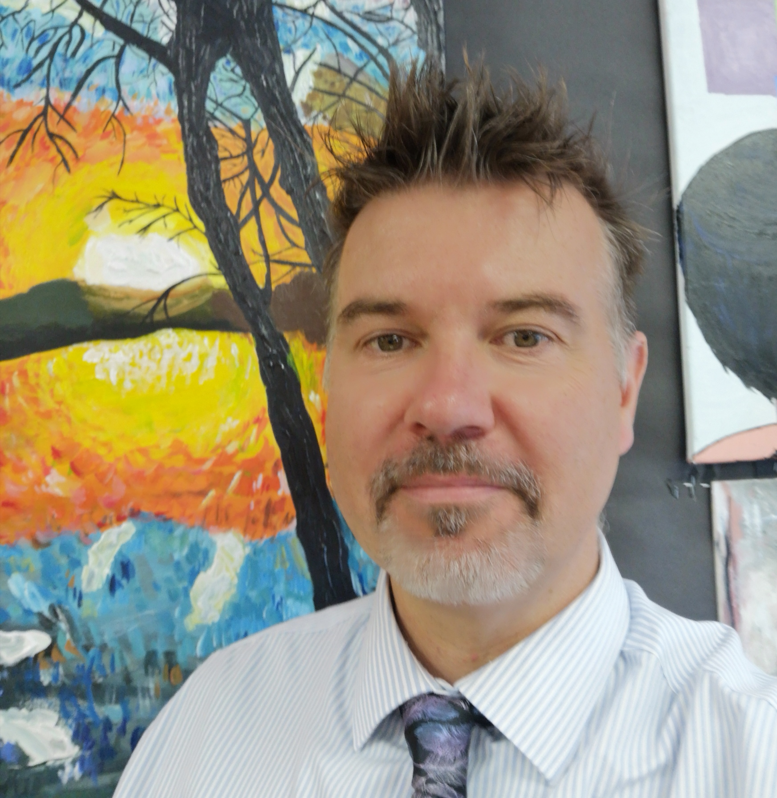
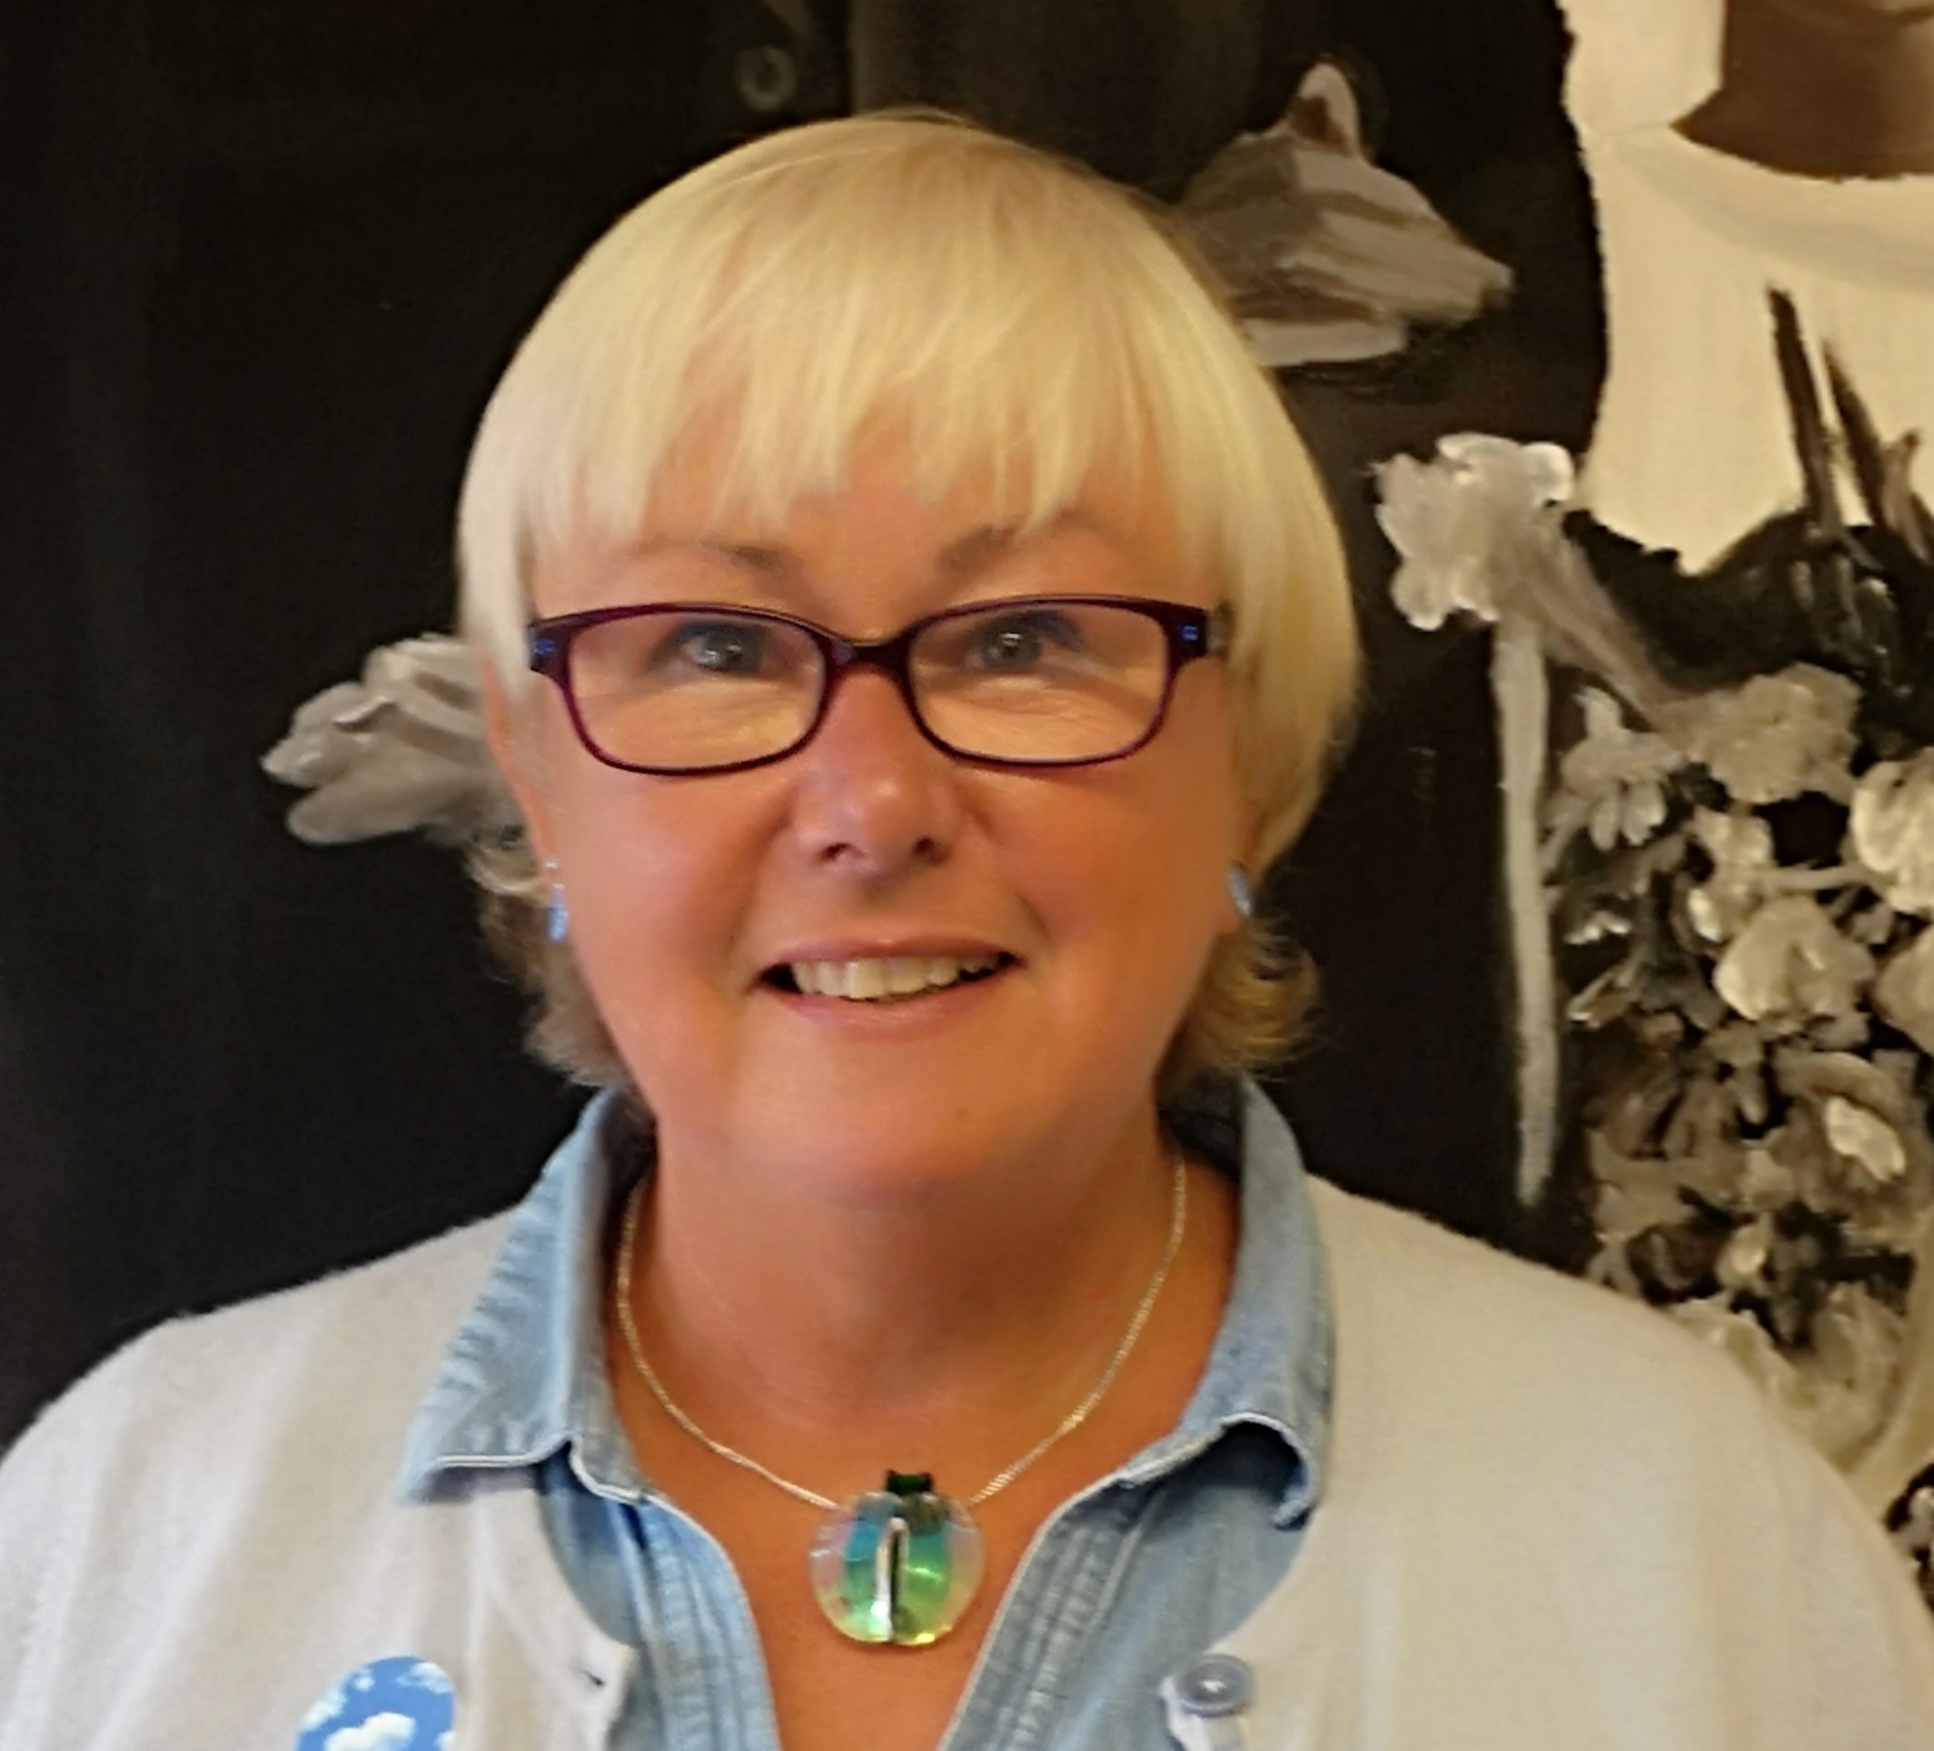
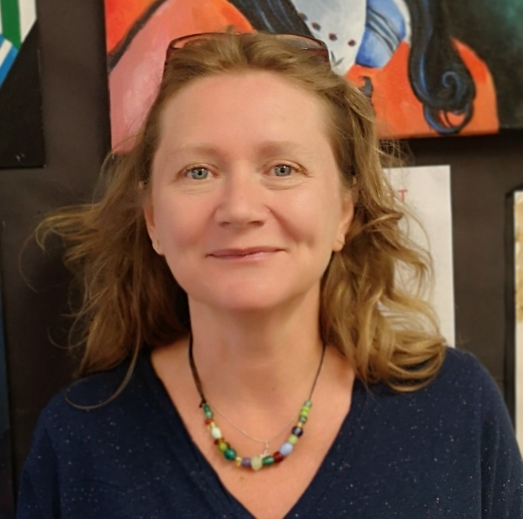
Meet the team:
Mr Bowen CTL of Art
Mrs Bowyer
Mrs Williams

Slide 3
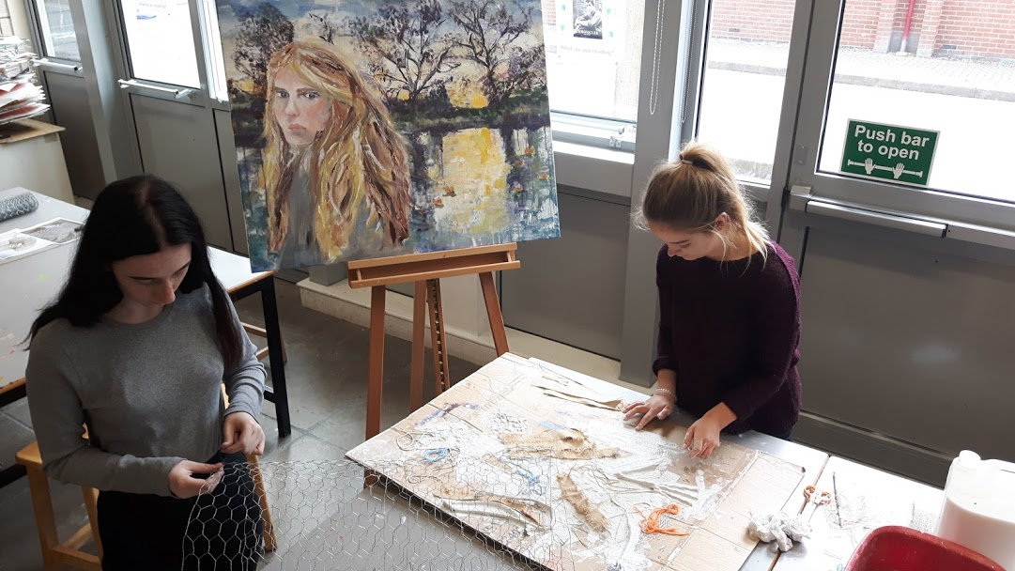
About the Course:
Press to start video introduction
Exam Board: Pearson BTEC

Slide 4
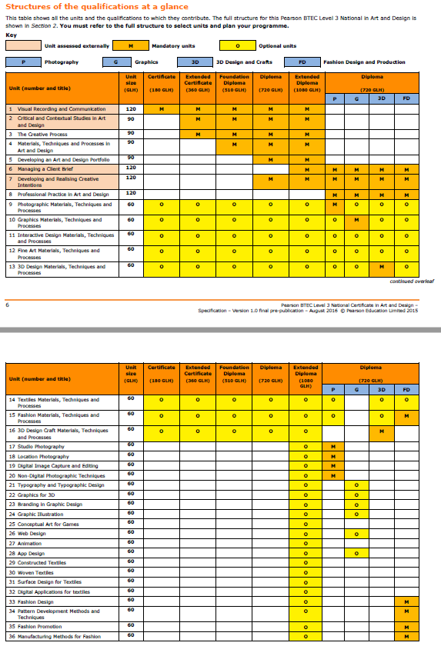
Internal Units:
Unit 3: Metamorphosis
Unit 12: The Container Project
Unit 16: The Rainforest Project
(Similar to GCSE coursework projects)

Slide 5
External Units:
Unit One: Visual recording and Communication
Unit Two: Critical and Contextual Studies in Art and Design
(Similar to GCSE exam projects)

Slide 6
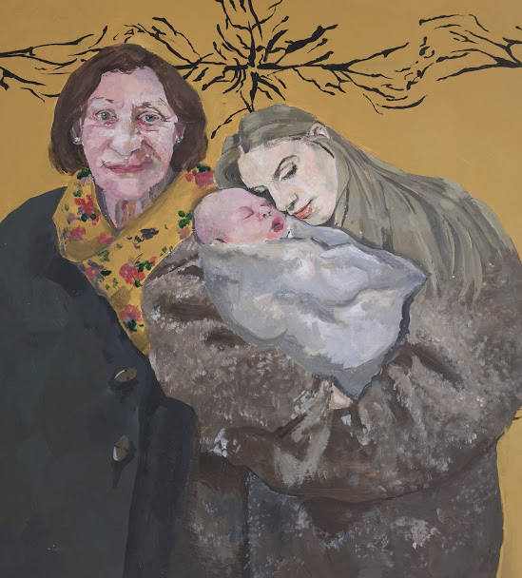
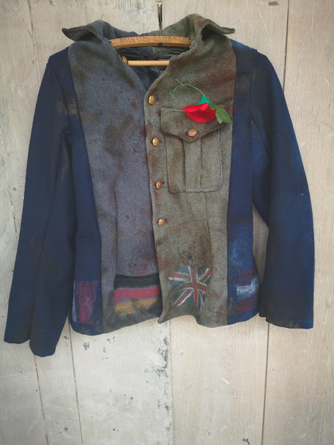
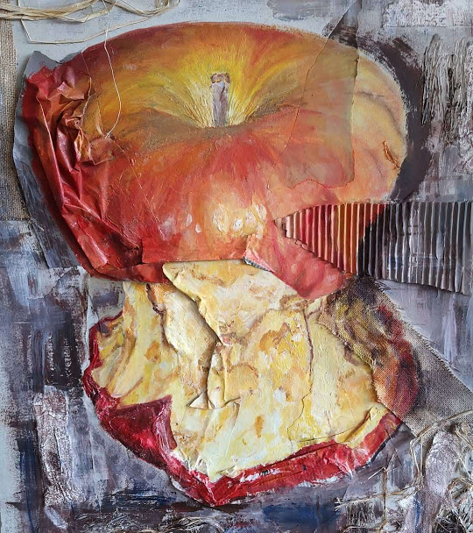
What will my work look like?
That is completely up to you.
(with a lot of guidance, of course...)

Slide 7
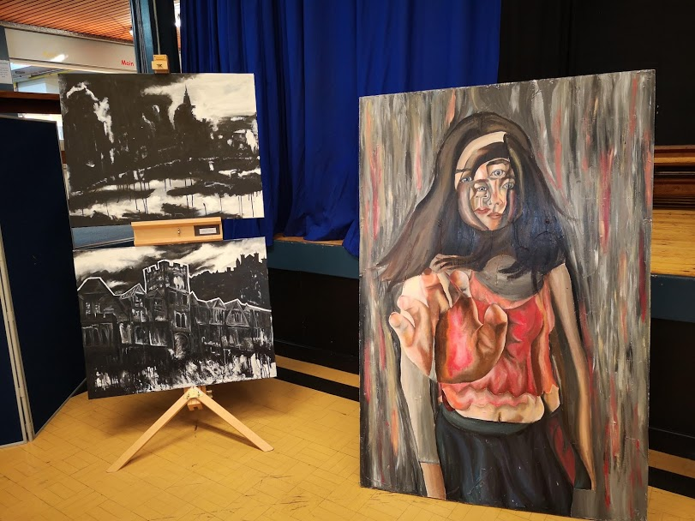
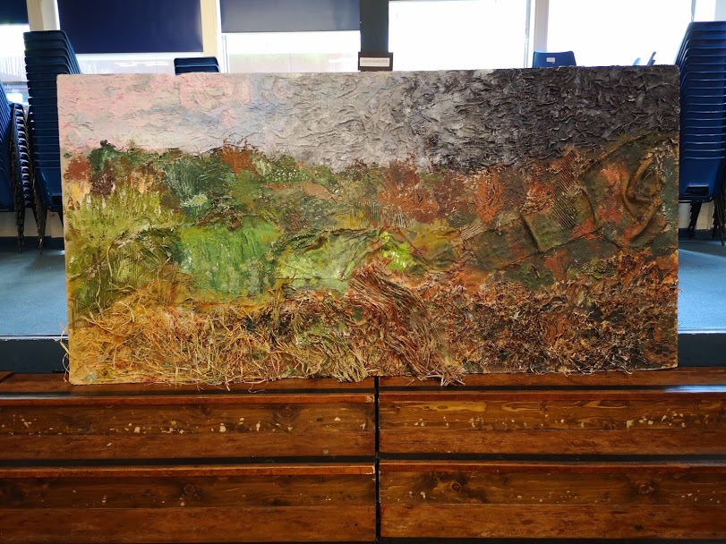
What will my work look like?
That is completely up to you.
(with a lot of guidance, of course...)

Slide 8
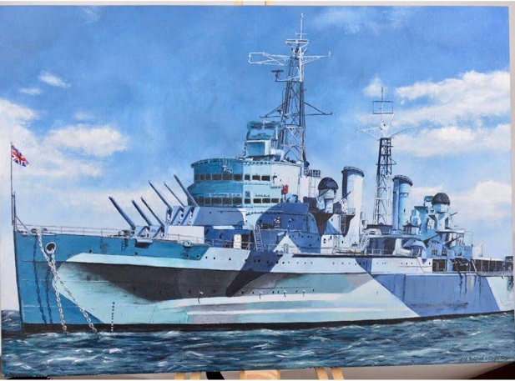
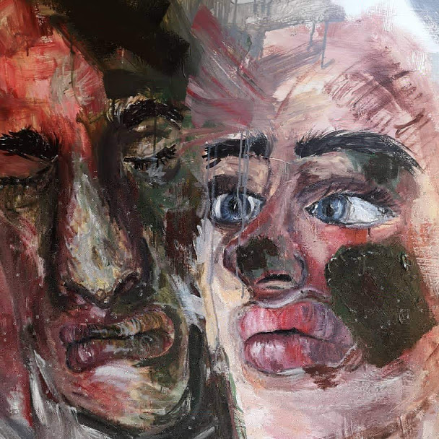
What will my work look like?
That is completely up to you.
(with a lot of guidance, of course...)

Slide 9
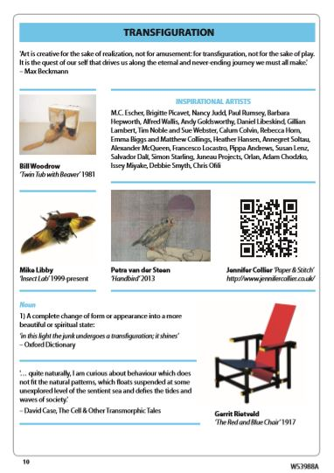
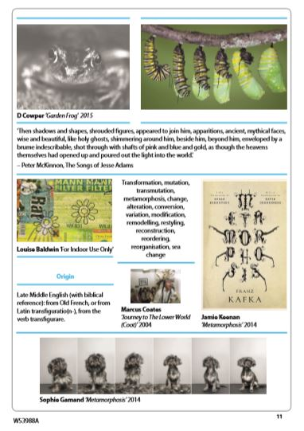
What does an exam question look like?

Slide 10
What can I do in the future?
…and that’s just the beginning.

Slide 11
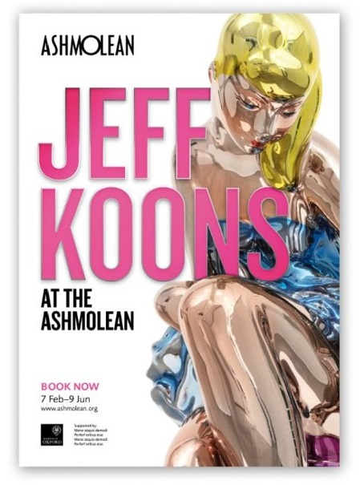
Do we go anywhere?
We go on regular trips to Art galleries. Here are a few from the last 12 months.

Slide 12
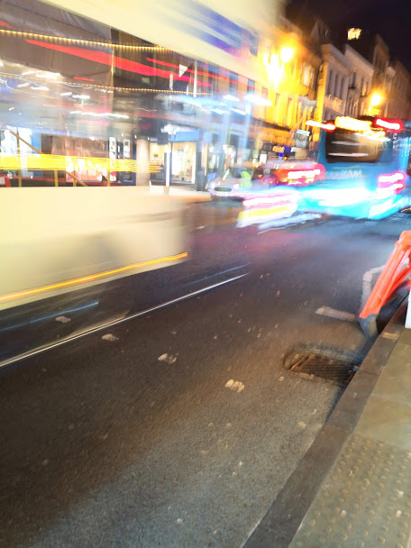
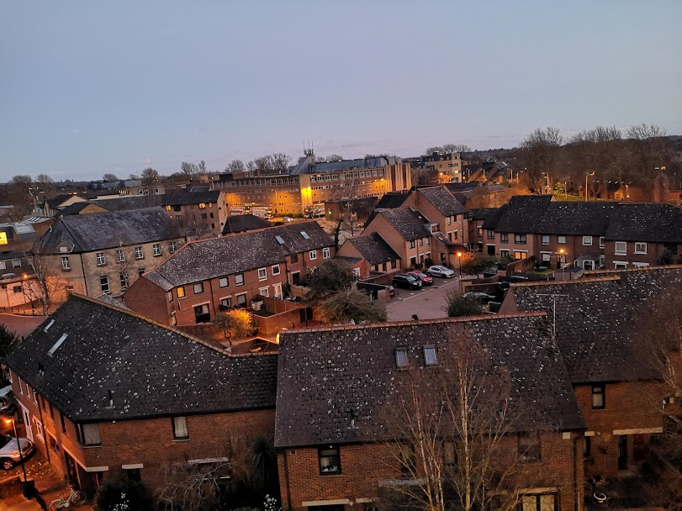
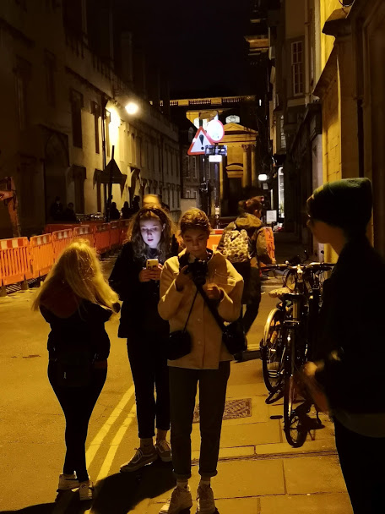
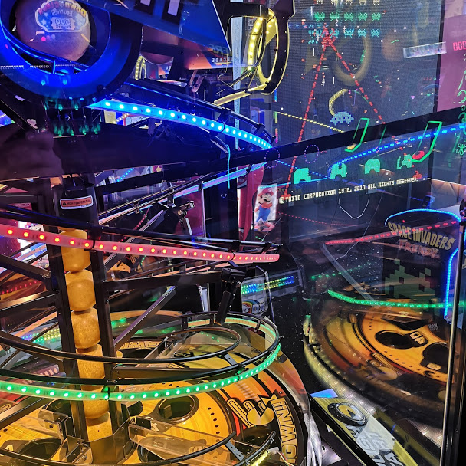
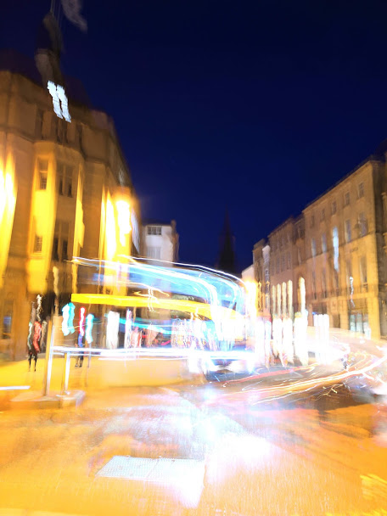
Do we go anywhere?
We go on trips to support particular exam questions. This was a trip to support a ‘Photography at night’ question.

Slide 13
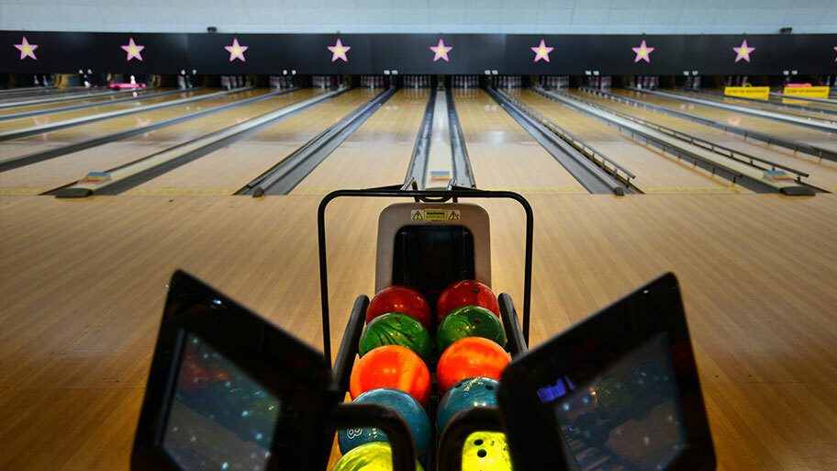
Do we go anywhere?
... And every year we go bowling.
It’s an Art tradition now.
(Optional but traditional.)

Slide 14
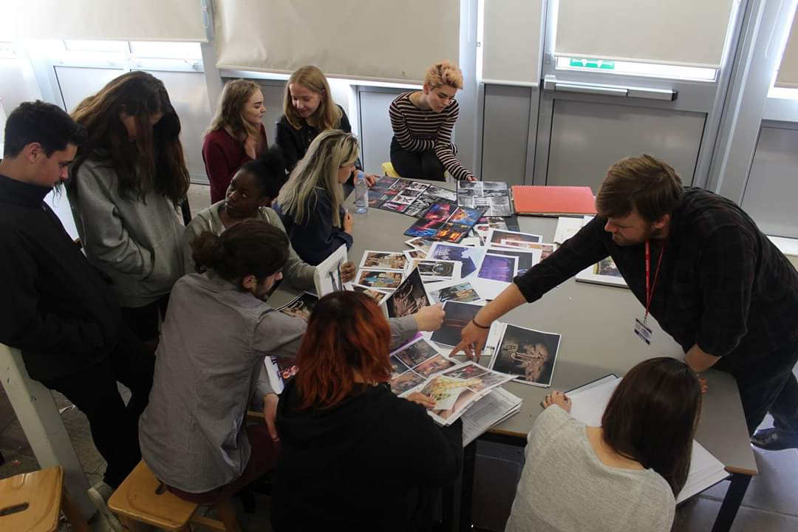
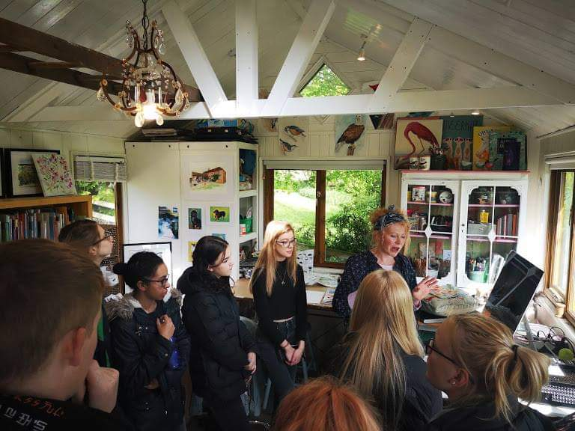
Do we get any visitors?
We have regular visits from artists and designers. For example, we visited artist Fay Ford in her studio, had a visit from an architect Paul Prince and Alfie Heywood, designer for the ENO, Coldplay and Take That.

Slide 15
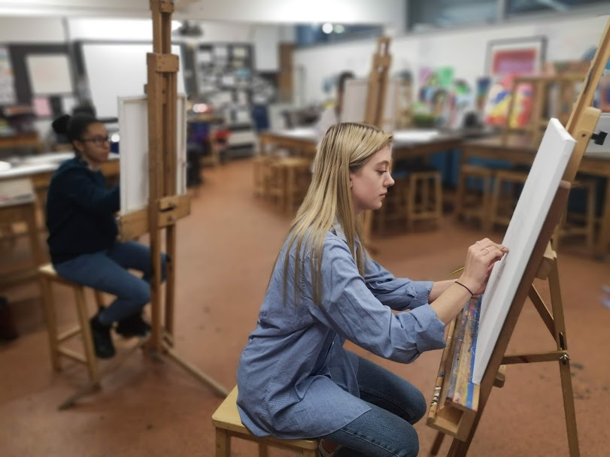
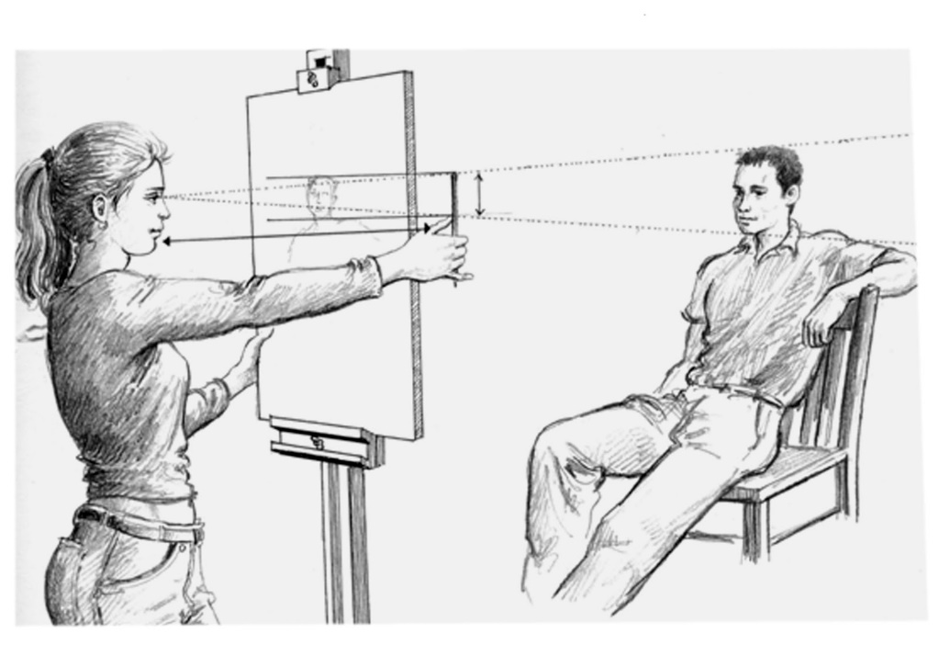
Life Drawing
Wednesdays
and
(some) Saturdays
(Working with a range of different models.)

Slide 16
6th Form Art Room A dedicated classroom for 6th Form artists only

Slide 17
Any questions?
If you have any further questions
please contact Mr Bowen on:
bowens@wallingfordschool.com

Slide 18
Good Luck and remember…

Slide 19
