Slide 1
Welcome
to Philosophy

Slide 2
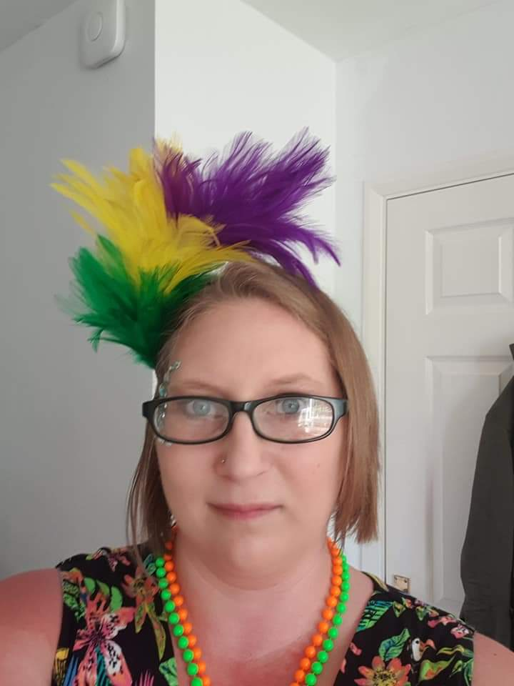
Meet the team:
Miss Y Frackiewicz Curriculum Coordinator for RS and Philosophy teacher

Slide 3
About the Course:
Exam Board:
Modules studied:
:
AQA
Epistemology
Moral Philosophy
Metaphysics of God
Metaphysics of mind
Hello and philosophy question

Slide 4
How does the two year course work?
Paper 1: Epistemology and Moral Philosophy
What is assessed? Sections 1 and 2 How is it assessed? Written exam: 3 hours 100 marks 50% of A level What type of question? Section A: Five questions on epistemology Section B: Five questions on moral philosophy
Paper 2: The metaphysics of God and the metaphysics of mind
What is assessed? Section 3 and 4 How is it assessed? Written exam: 3 hours 100 marks 50% of A level What type of question? Section A: Five questions on metaphysics of God Section B: Five questions on metaphysics of mind

Slide 5
How will you be assessed?
There are two assessment objectives (AOs) in the AQA A Level Philosophy course
AO1: How well you are able to show your understanding of the topic, ideas, methods and arguments and your ability to analyse and explain them by identifying the key ideas and showing how they fir together.
AO2: Tests your capacity to analyse philosophical positions, theories and arguments in order that you may evaluate how strong they are by exploring the quality of the reasoning, considering their implications and exploring objections and counter arguments.

Slide 6
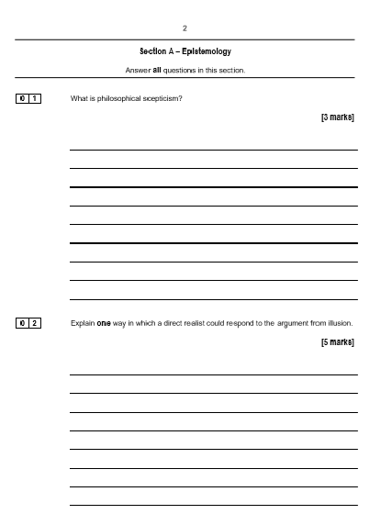
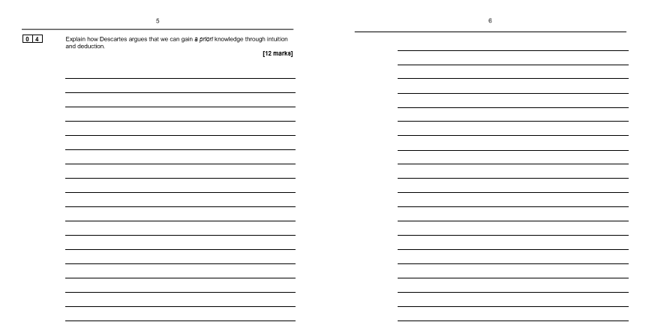
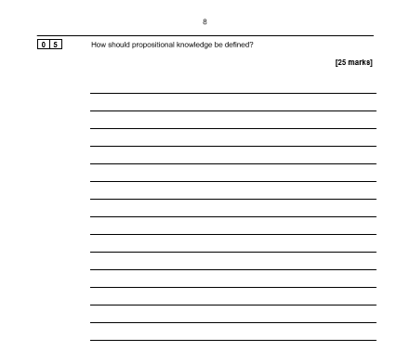
What does an exam question look like?

Slide 7
What does a typical lesson look like?
Listening to different ways of thinking
Being open minded
Weighing up arguments
Expressing & generating ideas
Considering & understanding others’ perspectives

Slide 8
What can I do in the future?
University courses that can require Philosophy are:
A. Law
B. Journalism
C. Philosophy, politics and economics
D. English
E. Teaching

Slide 9
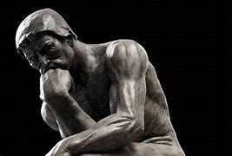
What do the students say?
Meet Charlotte Berry who is currently studying Philosophy.

Slide 10
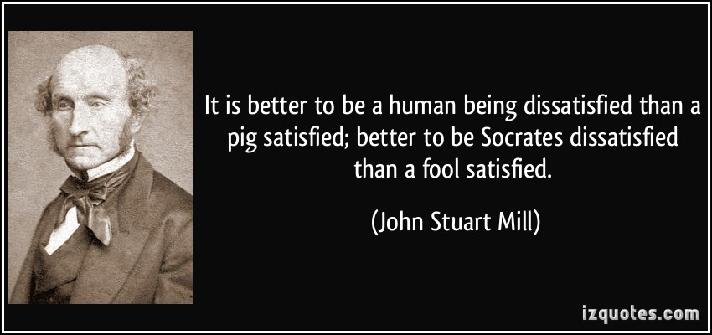
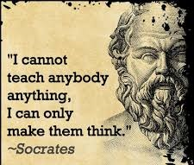
Final thoughts….
Is it better to question the world around you or to accept what you think you know to be true?
Do life’s BIG QUESTIONS stir a desire in you to delve deeper – to understand and debate?
Take Philosophy
It will do you good ☺

Slide 11
Any questions?
If you have any further questions please contact
Miss Frackiewicz on
frackiewiczy@wallingfordschool.com

Slide 12
Good Luck with the transition work, see you in September

