Slide 1
Welcome
to
A-Level
Physics

Slide 2
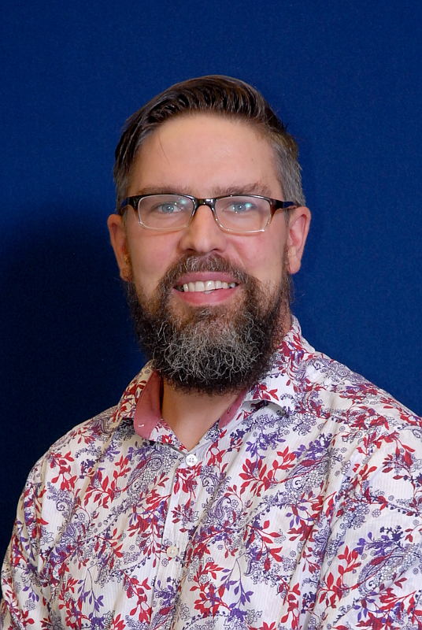
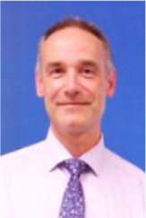
Meet the team:
Mr. T Payne -
Head of Physics
Mr. D Boddaert –
Head of Science

Slide 3
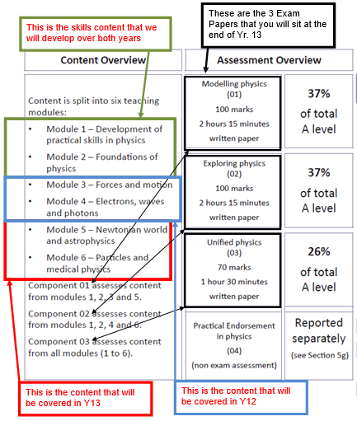
OCR Physics A:
2 Year A level course
Taught in order of AS
Yr12 - AS past papers
Yr13 – A-level past papers
3 Final Exams
Practical Endorsement
OCR Website

Slide 4
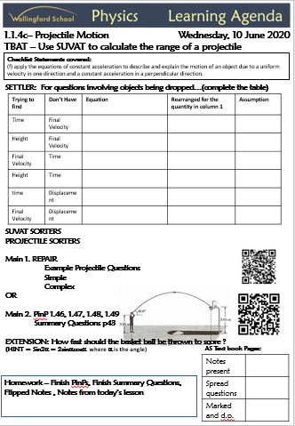
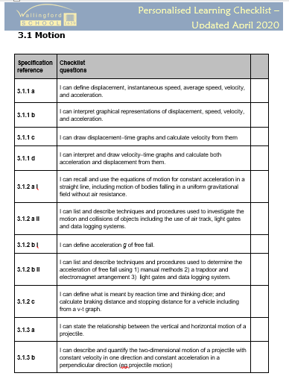
What does a typical lesson look like?
Learning Agendas
Lesson Menu
Homework
Spec Points
Personalized Learning Checklist

Slide 5
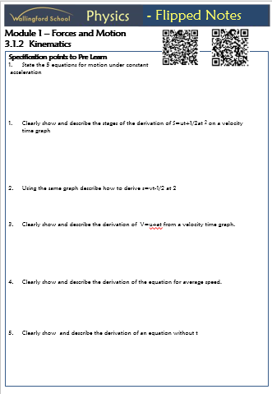
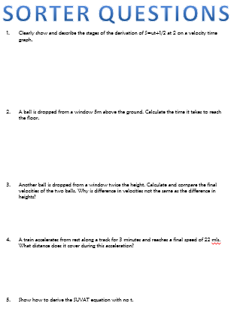
The Flipped Classroom “less talk =More support”
Flipped Notes
Independent learning
Sorter Qs

Slide 6
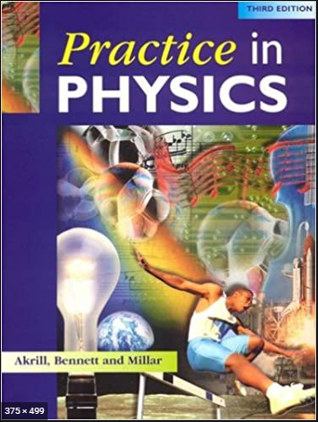
What does homework look like?
Same weekly basics
Next lesson’s Flipped Notes
Summary Qs
Finish PinPs or Worksheets
Notes

Slide 7
What can I do in the future?
University courses that can require
Physics are:
Physics
Engineering – Medical/Electrical/Mechanical
Maths
Medicine
Astronomy
Architecture

Slide 8
What do the students say?
Meet Hannah who is currently studying with us.
We asked her a series of questions about her experience of studying Physics at Wallingford school:-

Slide 9
Why did you choose A-Level Physics?

Slide 10
What have you enjoyed and what are you looking forward to?

Slide 11
What does a typical lesson involve?

Slide 12
Has anything surprised you about the course?

Slide 13
What does homework normally involve?

Slide 14
What advice to you have for someone starting the course?

Slide 15
Any questions?
If you have any further questions or need any additional guidance with the transition work please contact
Mr. Payne
paynet@wallingfordschool.com

