Slide 1
A-Level

Slide 2
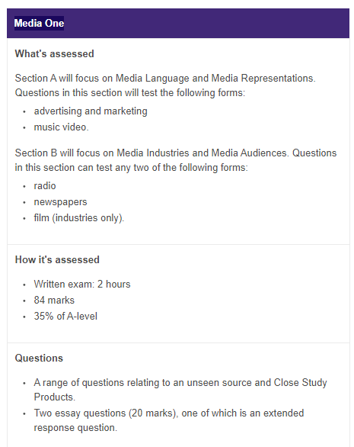
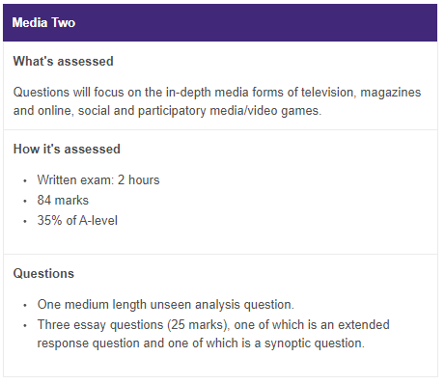

Slide 3
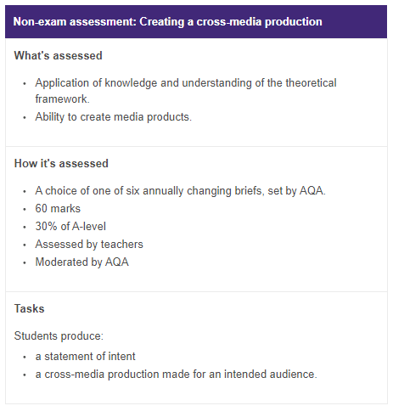
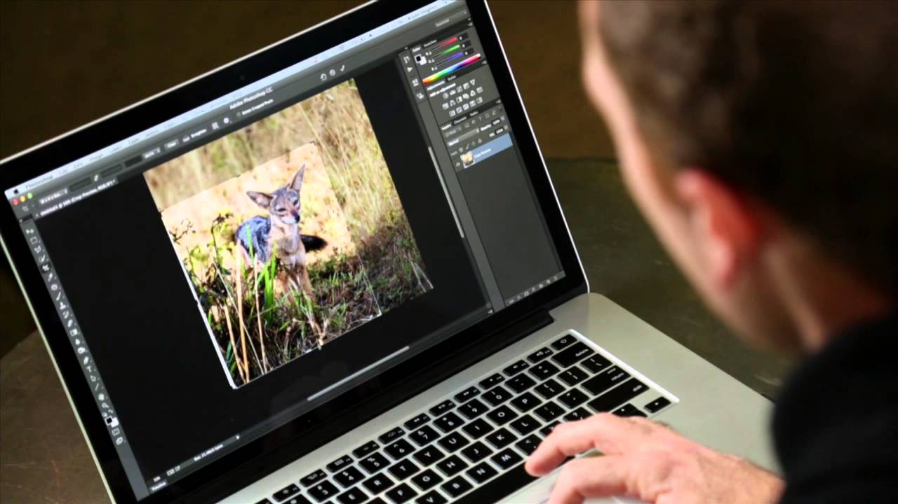
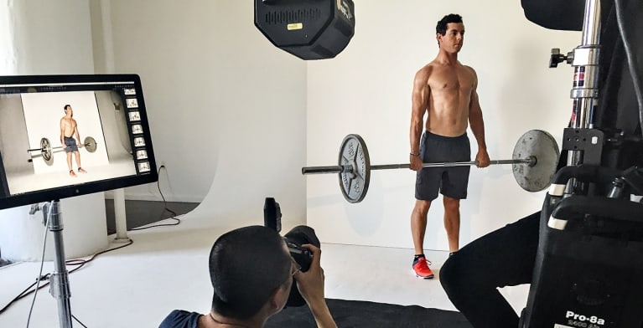
… the coursework
30% of your
A Level

Slide 4
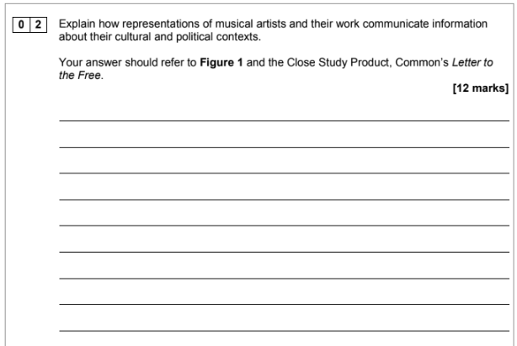
70% of your A Level – there are two papers that both have a range of short answer and longer questions.
Paper 1 covers a range of questions as well as an UNSEEN example which will then link to one of the CSPs (see left)
Paper 2 will also have an UNSEEN Analysis Question and then THREE broader ESSAY questions…

Slide 5
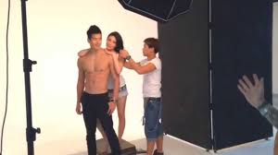
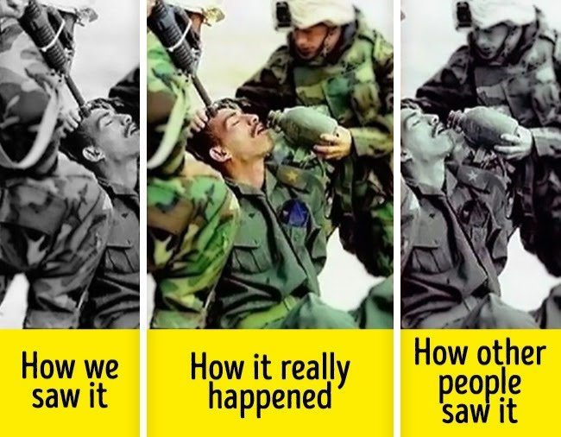
A Level Media Studies can compliment virtually any University or career choice… It gives you a range of skills:
The Ability to think VISUALLY
Excellent COMMUNICATION Skills
An understanding of how VALUABLE technology can be
Degree courses like Advertising, Communications or Design
Go into careers like Journalism,
Education or PR
An understanding of how IMPORTANT Media manipulation can be
Understanding the DIGITAL world is essential for tomorrow’s work

Slide 6
If you have any further questions - or need any additional guidance with the transition work please contact:
jacksonj@wallingfordschool.com

