Slide 1
Welcome
A Level Sociology

Slide 2
Meet the team:
Mr Lamb
Subject lead

Slide 3
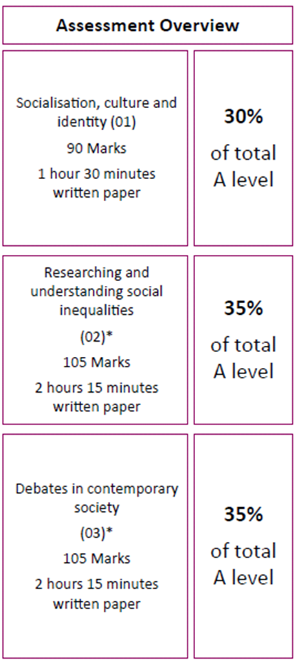
About the Course:
Six Units
Three Exams
Unit | Key Questions
Socialisation, Culture & Identity | What is our Identity (Class, Age, Gender, Ethnicity) and how is it formed? What are the different types of culture in Society?
Media | How are different groups represented in the Media? What is the impact of different forms of Media on Society?
Research Methods | How do Sociologists research inequalities in society and make sure that the results are meaningful?
Social Inequalities | Why are women, ethnic minority groups, young people, elderly people and the working class all disadvantaged in Society? Or are they?
Globalisation & the Digital World | What is the link between globalisation & digital communication? What is the impact of modern digital communication on our society?
Crime & Deviance | Why do people commit crime? What are the patterns of crime in our society?
Year 12
Year 13

Slide 4
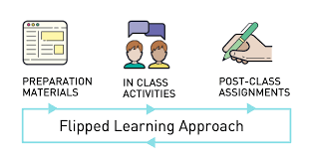
What does a typical lesson look like?
Before the lesson, students are expected to complete ‘flipped learning’ or pre-learning, This will often be research or notes from resources, with guidance about what to focus on.
Students therefore arrive to lessons with an understanding of topics already. In the lesson we can spend time on activities, sharing ideas, checking understanding and focusing on the aspects students have found challenging.
Finally, in both lessons and for homework, we apply our understanding to exam questions or essays – don’t worry, they’ll be lots of support for this!

Slide 5
What does an exam question look like?
Sociology is an essay-based subject. Within the 3 exams, questions range from 4 marks to 40 marks. In all answers, students need to write in full paragraphs with a range of key terms, sociological studies, theories, statistics and contemporary examples from the real world, all in a clear logical structure.

Slide 6
What can I do in the future?
Anything you want to!
Sociology is a very broad subject that covers a huge range of issues, topics and ideas from the whole of society.
Whatever you choose to do in the future, the things you’ve learned in Sociology will undoubtedly be useful.

Slide 7
What do the students say?
Please watch the Sociology clips. Some former Sociology students talk honestly about their experiences… They give a fantastic summary of this wonderful subject!

Slide 8
Any questions?
If you have any further questions or need any additional guidance please contact Mr Lamb on lambn@wallingfordschool.com
Good Luck with the the rest of Year 11, see you in September 2021!

