Slide 1
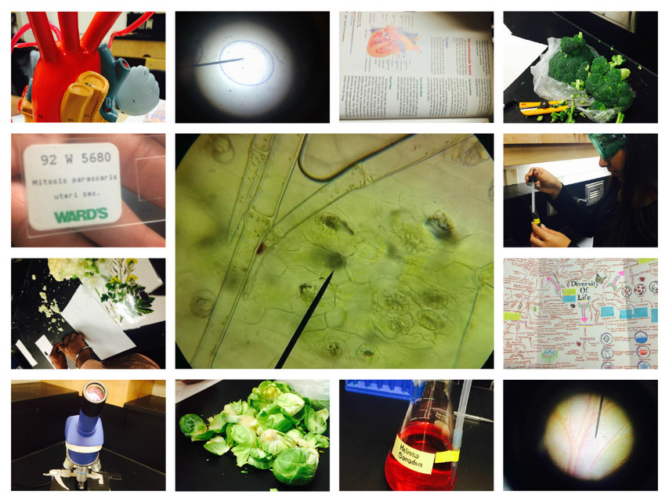
Biology A-Level Virtual Taster

Slide 2
A-Level Biology Basic details
Exam board - OCR Biology A
Number of modules - 6
Number of exams - 3

Slide 3
Course Structure
Module 1 – Development of practical skills in biology
Module 2 – Foundations in biology
Module 3 – Exchange and transport
Module 4 – Biodiversity, evolution and disease
Module 5 – Communication, homeostasis and energy
Module 6 – Genetics, evolution and ecosystems

Slide 4
Typical Lesson
Sorter
Main sections
Plenary

Slide 5
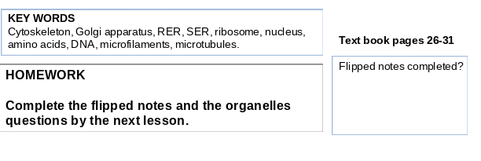
Homework

Slide 6
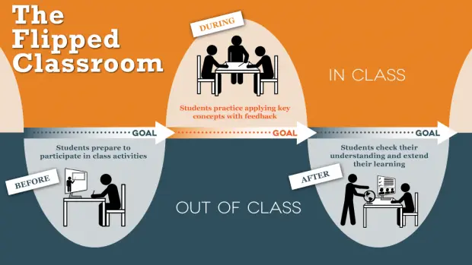
Flipped Notes

Slide 7
Course / Exam structure
Module 1 – Development of practical skills in biology
Module 2 – Foundations in biology
Module 3 – Exchange and transport
Module 4 – Biodiversity, evolution and disease
Module 5 – Communication, homeostasis and energy
Module 6 – Genetics, evolution and ecosystems
Exam 1 Biological processes

Slide 8
Course / Exam structure
Module 1 – Development of practical skills in biology
Module 2 – Foundations in biology
Module 3 – Exchange and transport
Module 4 – Biodiversity, evolution and disease
Module 5 – Communication, homeostasis and energy
Module 6 – Genetics, evolution and ecosystems
Exam 1 Biological processes
Exam 2 Biological diversity

Slide 9
Course / Exam structure
Module 1 – Development of practical skills in biology
Module 2 – Foundations in biology
Module 3 – Exchange and transport
Module 4 – Biodiversity, evolution and disease
Module 5 – Communication, homeostasis and energy
Module 6 – Genetics, evolution and ecosystems
Exam 1 Biological processes
Exam 2 Biological diversity
Exam 3 Unified Biology

Slide 10
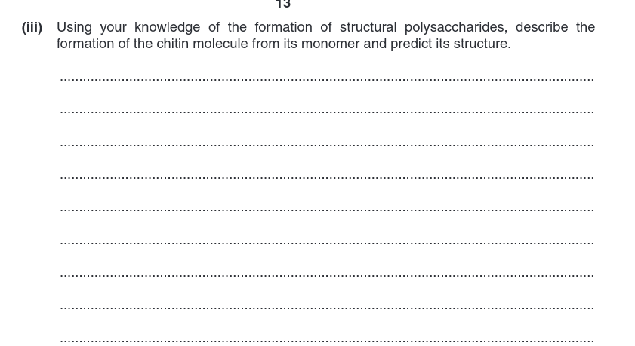
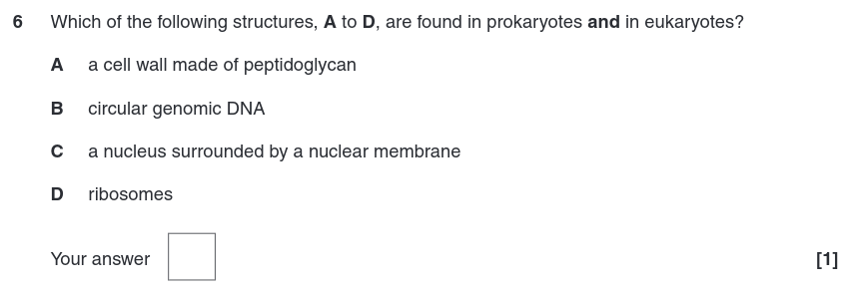
Exam Questions

Slide 11
Video Version
A version of this presentation with video testimonials from current sixth form members can be found in the sixth form section of the VLE.
https://vle.wallingfordschool.com/mod/folder/view.php?id=10731

